Slide 1
What I have built so far: fifteen working legal tools
Built on my own time with invented clients. Orange: usable right away. I will demo two.
CONFLICTS AND INTAKE
TRANSACTIONS AND PRACTICE GROUPS
Conflion
Finds the conflicts a letter-for-letter search misses and routes each intake to the right approvers.
Matter Desk
First read of a new matter in five practice areas, with every deadline dated.
Party Finder
Reads the complaint or deal papers and lists every name to run, so intake misses no one.
Synthesis
Buy-side deal workbench: schedules against reps, the markup explained, closing list built.
LexAtlas
Maps how companies, people and matters connect, for conflicts and diligence.
Skippy
Answers questions about a matter's files, every answer cited to the page.
VigilMark
Ranks new trademark filings against clients' marks before the opposition window closes.
BILLING AND TIME
Guideline Guard
Checks each prebill against that client's own guidelines and proposes the fix.
LITIGATION
Win your case ASAP
First read of a complaint: which motions could end the case early, with filing dates.
Hour Catch
Reads a lawyer's day in Outlook and Teams and drafts the time entries that would be lost.
Testimony Check
Finds where a witness's story conflicts with the documents and drafts the deposition outline.
FIRM STRATEGY AND MARKETING
Citation Gate
Checks every cited case and quotation against real opinions before a brief goes out.
Praxis
Lets leadership compare AI ideas on impact, risk and effort, and track the pilots.
Case Wins Debrief
Turns each trial win into lessons and a tool the next team can reuse.
Marketing Studio
Drafts bios, client alerts and RFP responses in the firm's voice, then checks the rules.

Slide 2




How I use AI: three layers, from chat to automation
Each layer does more on its own, so each needs more care around it.
1 Chat
2 AI-assisted tools
3 Automation
Working with AI directly
AI inside a tool built for one job
Work that runs in the background
Drafting, summarizing, research and checking my own work. Anyone at the firm could start here.
Checks around the model and a person deciding. Guideline Guard checks prebills; Testimony Check preps depositions.
Nobody has to ask; a person reviews what it finds. VigilMark watches new trademark filings; Conflion routes each intake.
Using AI, and using AI to build tools
I also use AI to build layers 2 and 3, so lawyers get the benefit without having to learn AI. Every build follows the same steps: start with how the work is really done, build, test against real outcomes, and ship it with tests, guides and a features list for IT.

Slide 3

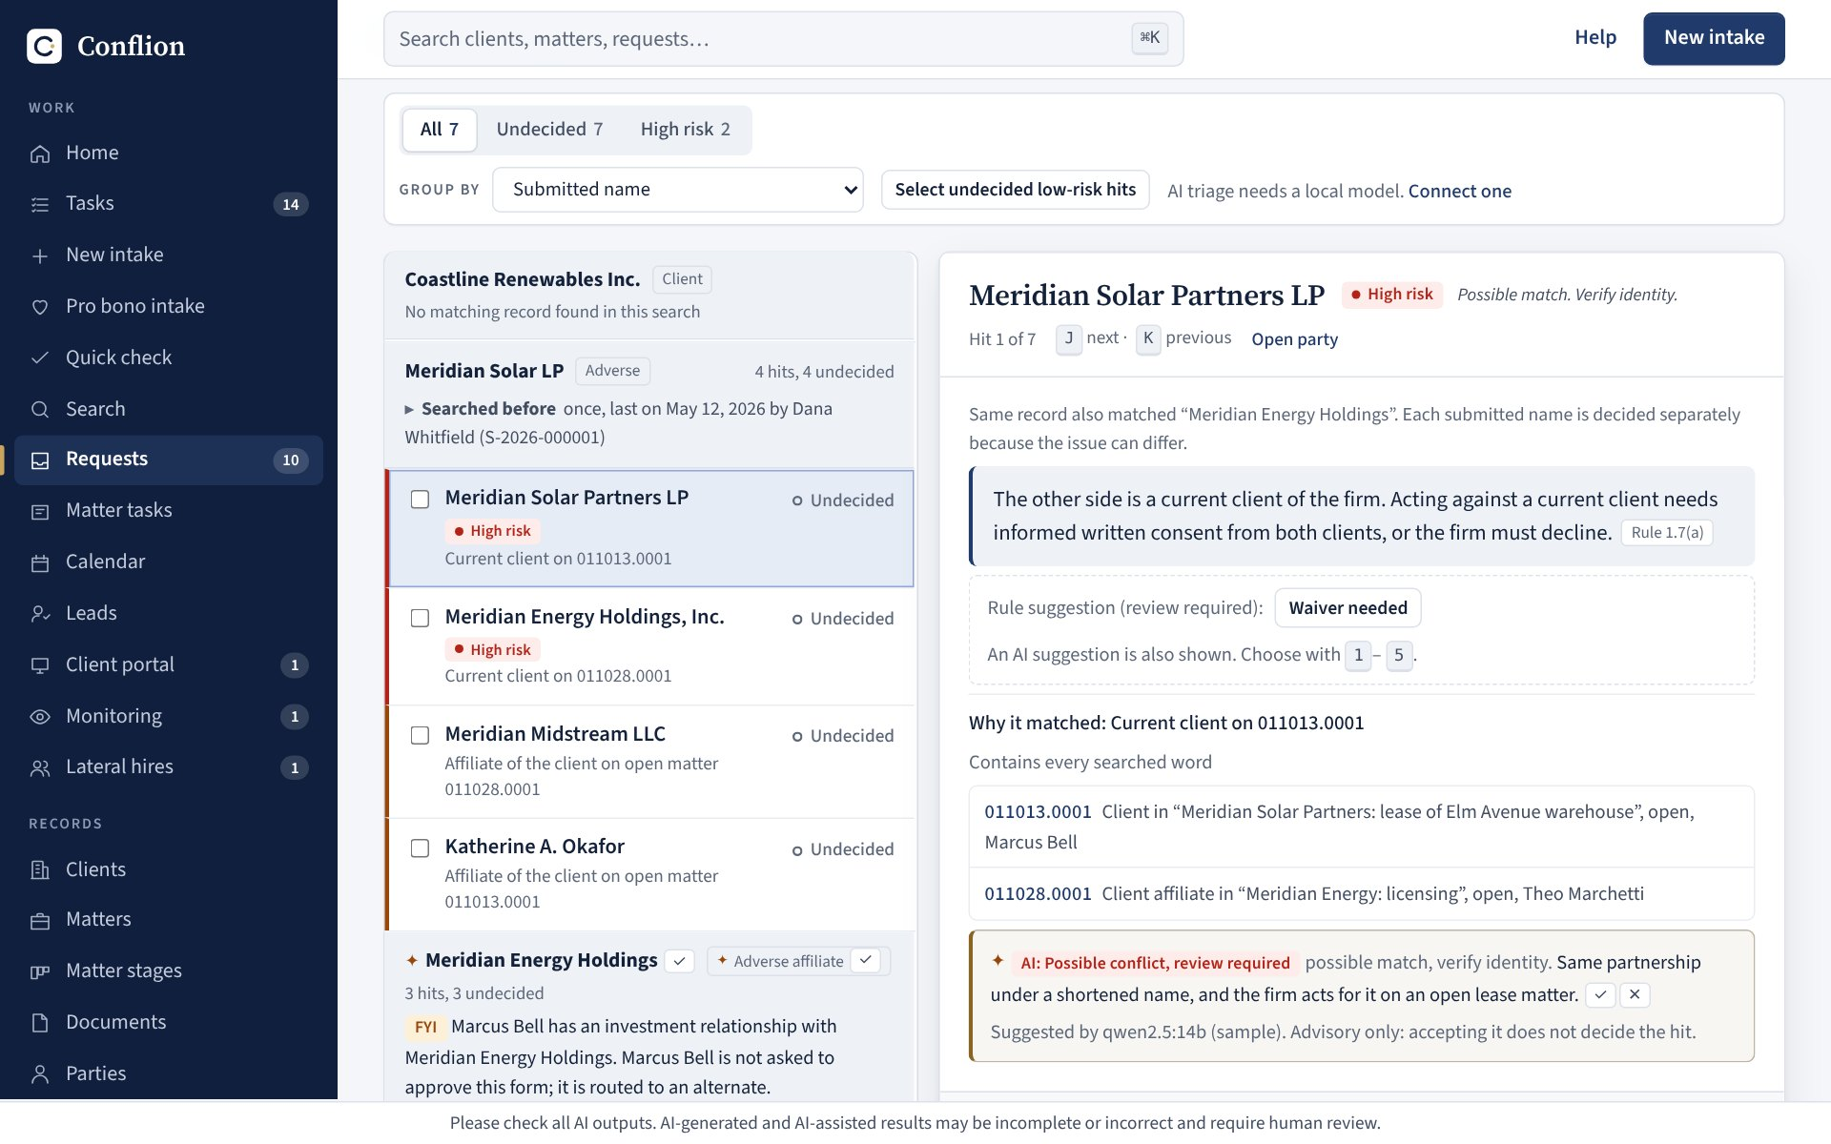



Conflion brings all of this together
A conflicts and intake system that uses all three layers, built the way I think firm AI should be.
Secure
Sign-on and roles. Ethical walls enforced in what each user can see. A tamper-evident audit trail.
Connected
Each intake routes to the right approvers. Walls feed a block list for the document system.
Local model
The AI runs on the firm's own hardware, so client names never leave the building.
Hit review: each match explained in plain English. The AI note is marked advisory; a person decides.
Built to our rules
Catches what a letter-for-letter search misses (Smyth, Kate for Katherine, parent companies) and cites the conduct rule.
It ships with role-based training walkthroughs. The same pattern could serve any workflow here.

Slide 4


What I could build next, from small to firm-wide
Ideas I think are worth exploring. Which ones, and in what order, is leadership's call.
Start small
Connect
Firm-wide, for discussion
Use what already works
Plug proven tools into firm systems
One firm-owned platform
An AI dashboard on every computer that steers people to approved, easy tools.
Start it with Guideline Guard, Party Finder and Marketing Studio.
No firm-system connection; a person reviews every output.
Client risk tracker: spot trouble so we call the client before they know they are being sued.
Custom newsletters for attorneys and training videos for new hires.
Ask the matter and Hour Catch on firm systems.
Every tool as a module over all files, matters and systems.
One set of permissions, one audit trail, models on firm hardware.
Includes a knowledge engine: "who here has handled this?"

Slide 5


How I can help the firm with AI
Two ways I can be an asset, each backed by work already done.
AI tools and implementation
AI strategy going forward
Building, testing and rolling out tools
An ethos for choosing what to pursue
Fifteen working legal tools, each built and tested end to end.
Built for client data: local models, ethical walls, audit trails (Conflion).
Rollout that sticks: walkthroughs, plain-language guides and training.
Safety-minded and honest about what AI cannot do.
Streamline real work; never add make-work.
Weigh new capabilities (risk tracker) against refining what we do (M&A review).
Practice impact and quality of life, with an eye on optics.
For discussion
Which problems would you most like AI to solve here, and how could I help?

